Slide 1
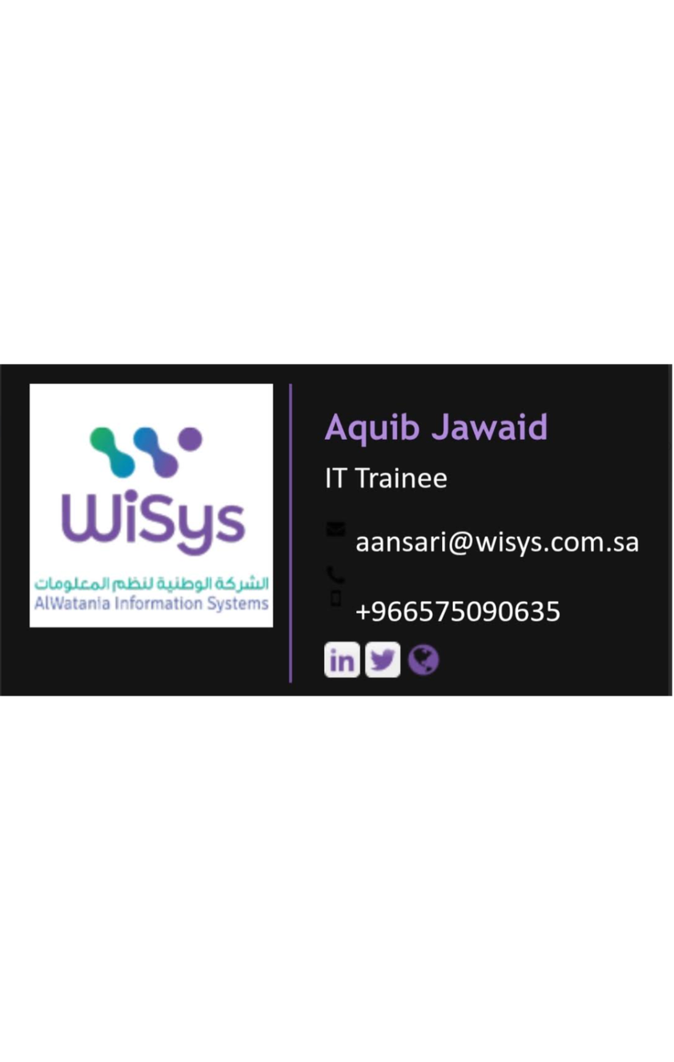

SUMMER 2026 · INTERNSHIP
SUMMER
INTERNSHIP
PPT
IT Trainee · Managed Services
AQUIB JAWAID ANSARI · REG. NO. 12508688 · B.TECH CSE — 5TH SEMESTER
LOVELY PROFESSIONAL UNIVERSITY · SUMMER 2026
AL WATANIA INFORMATION SYSTEMS (WISYS)

Slide 2
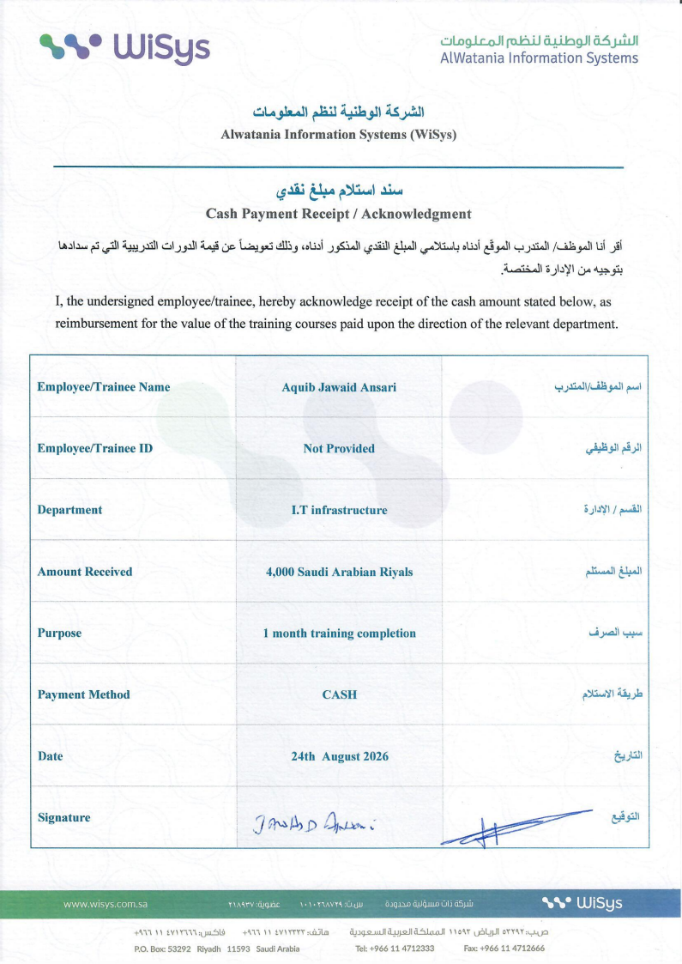
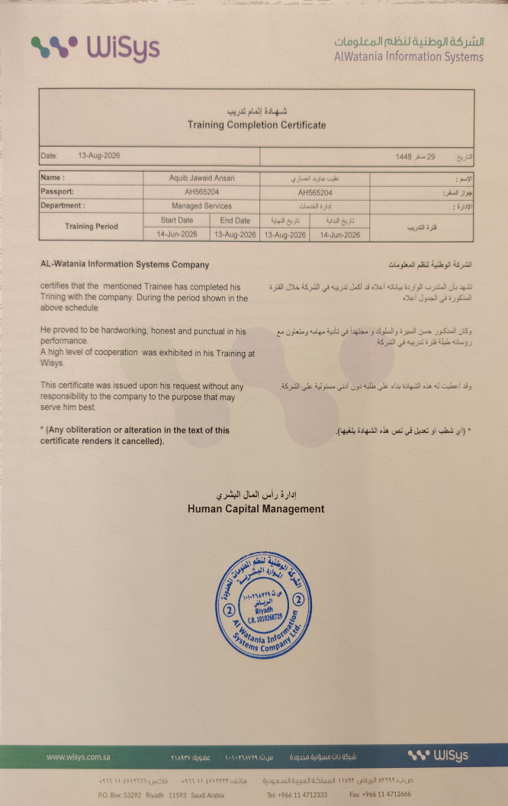

Slide 3
CONTEXT
01
Al Watania Information Systems (WiSys)
COMPANY
Riyadh, Saudi Arabia. Works with government and private
& ROLE
organizations.
02
Leadership
Mohammed Aliyady, CEO / General Manager.
03
Awqaf Context
Awqaf Sulaiman Bin Abdulaziz Al-Rajhi, historically reported market
value of approximately SAR 50 billion.
04
My role
IT Trainee — Managed Services, Summer 2026.
RIYADH · SAUDI ARABIA

Slide 4
PRACTICAL EXPOSURE
CLOUD, MONITORING
AND SECURITY
The internship provided practical exposure to cloud infrastructure, monitoring, security and managed services.
Main areas: cloud infrastructure, cloud monitoring, alert configuration, security analysis, troubleshooting,
documentation, multi-cloud environments.
Cloud Infrastructure
Monitoring & Alerting
Security Analysis
Cloud infrastructure
Cloud monitoring and alert
Security analysis
configuration
Multi-Cloud Exposure
Applied Learning
Multi-cloud environments
Troubleshooting and documentation

Slide 5
Worked with
My work included
GCP SEHATI
MONITORING
GCP IAM
Troubleshooting cloud
& OPS
Audit Logs
infrastructure
Cloud Logging
Configuring monitoring
Cloud Monitoring
and alerts
Practical exposure to the GCP
VPC networking
Monitoring infrastructure
Sehati project.
Firewall configurations
events
Reviewing configuration
changes
Understanding cloud
operational issues
MANAGED SERVICES · CLOUD OPERATIONS

Slide 6
EVENT VISIBILITY
MONITORING MADE
CHANGE VISIBLE
Monitoring helped identify infrastructure, security and configuration events.
Infrastructure events
Configuration / security events
VM start, VM stop, VM deletion
IAM policy changes
Instance restarts
External IP assignments
CPU utilization, disk utilization
Firewall changes
Host errors
Storage bucket operations, disk operations
Machine-type changes

Slide 7
SECURITY MONITORING
Security monitoring across Google Cloud and
Huawei Cloud
Google Cloud Security
Gemini in Google Cloud
Huawei Cloud: Cloud Eye
Command Center
and Simple Message
Notification (SMN)
Identify major security
Infrastructure and resource
findings; analyze
analysis; configuration
Monitoring, alerting,
infrastructure
analysis, recommendations;
notifications; critical/severe
misconfigurations;
potential issue
infrastructure events; multi-
investigate potential impact
identification.
account and multi-project
and review affected
environments.
infrastructure; prepare
security documentation;
recommend configuration
improvements.

Slide 8
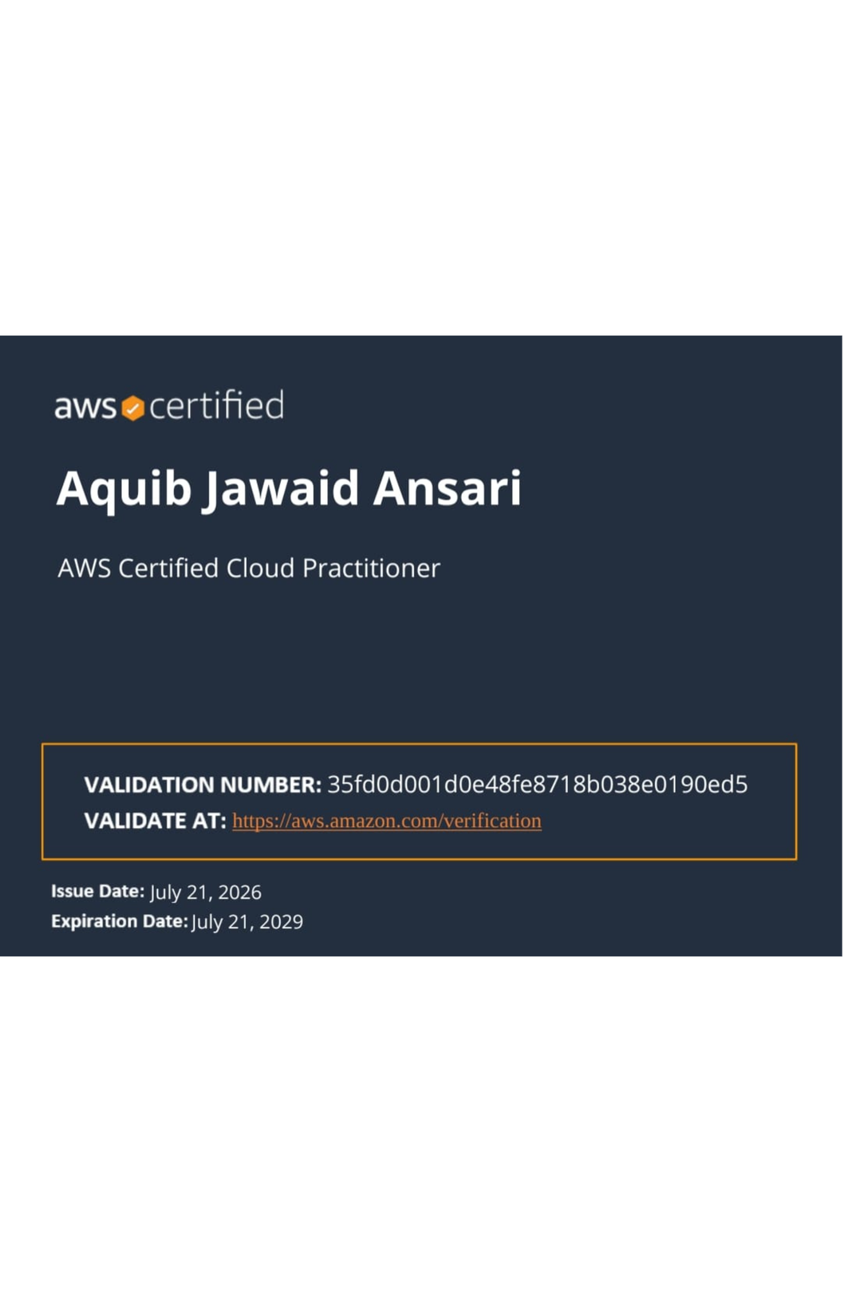
MULTI-CLOUD EXPOSURE
BEYOND A
SINGLE PLATFORM
Google Cloud
Huawei Cloud
Monitoring, security and
Cloud Eye and SMN
infrastructure
AWS
OCI
Cloud knowledge and practical
Cloud exposure
exposure
AWS Certified Cloud Practitioner
The certification was sponsored by Al Watania Information Systems
during my internship.

Slide 9
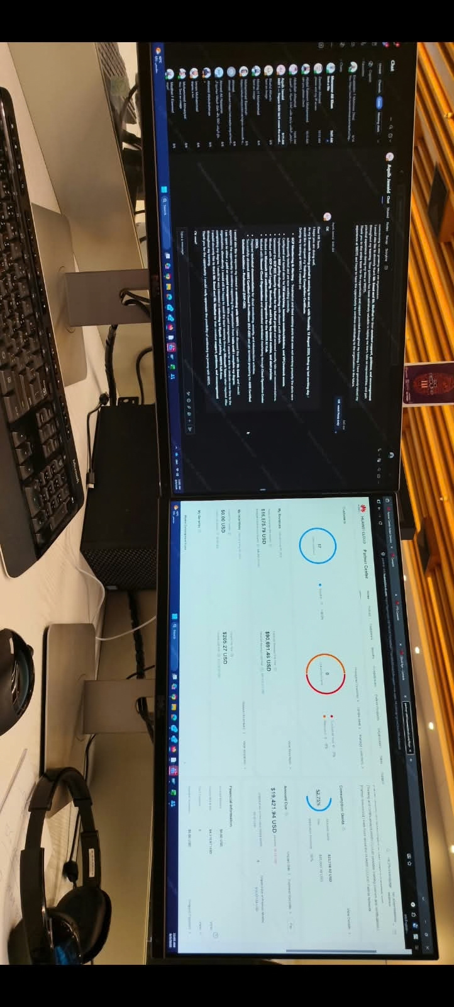
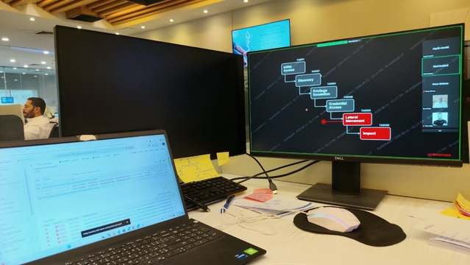
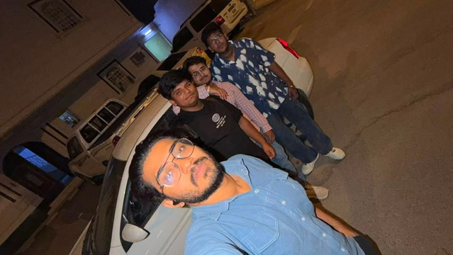
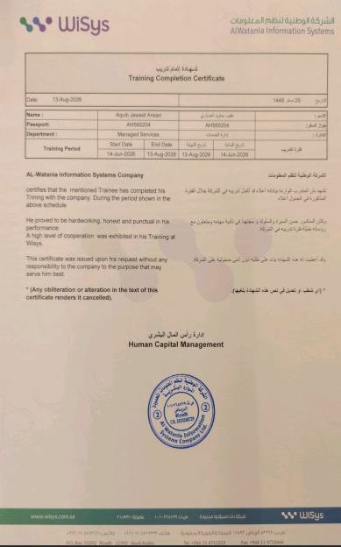
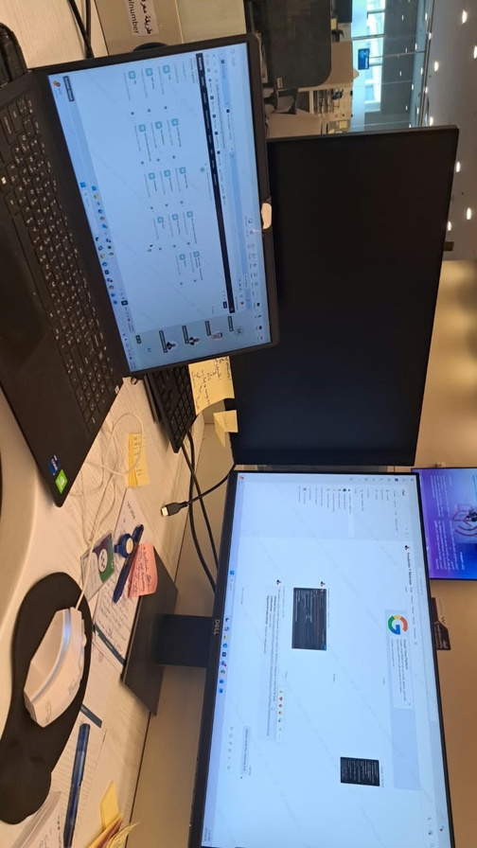
Internship evidence
WORKSTATION
WITH COLLEAGUES / TEAM
INTERNSHIP TRAINING COMPLETION
CERTIFICATE
Workstation

Slide 10
ACADEMIC PROJECT
Inspired by internship exposure to cloud monitoring, alerting,
MULTI-CLOUD
security findings, multi-cloud environments and infrastructure
ALERTING
events.
01
02
03
04
05
PLATFORM
Cloud
Monitoring
Security
Alerts
Dashboard
Environme
Rules
-nts
Design and Development of a
Multi-Cloud Infrastructure
Monitoring and Security Alerting
Platform
20/20
Automated tests implemented and passing
ISOLATED · NON-PRODUCTION · ZERO-
100% PASS RATE FOR THE IMPLEMENTED TEST SUITE · NOT CODE COVERAGE
COST ACADEMIC PROTOTYPE

Slide 11
REFLECTION
Cloud
Security
WHAT
GCP, Huawei Cloud, AWS, OCI,
IAM, security findings, audit logs,
I LEARNED
multi-cloud concepts
firewall configurations,
infrastructure security
Operations
Professional
Monitoring, alerting,
Team collaboration, enterprise
troubleshooting, documentation
environment, technical
communication, problem solving
THE INTERNSHIP CONNECTED ACADEMIC CLOUD CONCEPTS WITH
PRACTICAL EXPOSURE TO ENTERPRISE INFRASTRUCTURE,
MONITORING, SECURITY AND MANAGED SERVICES.
THANK YOU · AQUIB JAWAID ANSARI · REG. NO. 12508688 · B.TECH CSE — 5TH SEMESTER
SUMMER 2026 · MANAGED SERVICES
LOVELY PROFESSIONAL UNIVERSITY

